Slide 1
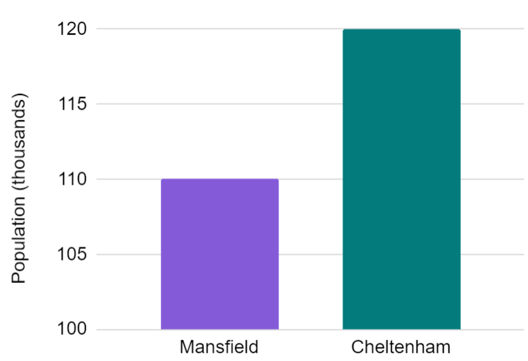


Statistical problems - data presentations
Task A: Presenting data clearly using graphs
1) The graph shows data from the ONS about the population of two towns in 2019.
Cheltenham has twice as many people as Mansfield.
Izzy
a) Explain why Izzy might think this, based on the bar chart.
The bar for Cheltenham is twice as long as the bar for Mansfield.
b) Explain why this is wrong.
The scale does not start at zero. There are 110 thousand people in Mansfield and 120 thousand people in Cheltenham.
2) The table shows data from the ONS about five towns in 2019.
Complete the scale on the axes of the scatter graph.
population (thousands) | number of properties sold
131 | 2012
140 | 2300
156 | 2279
160 | 2390
171 | 2491
2500
2400
2300
number of properties sold
2200
2100
2000
120
130
140
150
160
170
180
population (thousands)

Slide 2
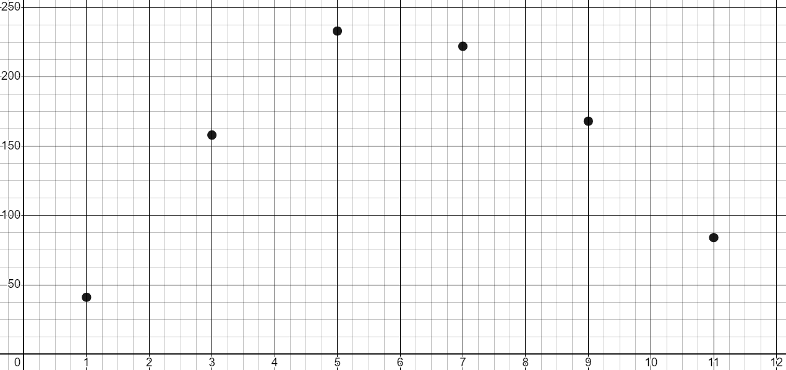
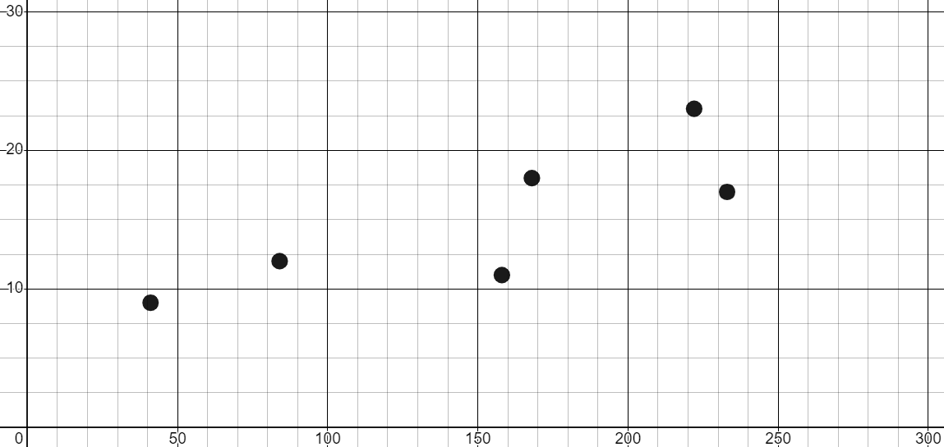
Statistical problems - data presentations
Task B: Choosing how to present data to illustrate a point
1) The table shows weather data from The Met Office for Cardiff in 1995.
month | sunshine duration (hours)
1 | 41
3 | 158
5 | 233
7 | 222
9 | 168
11 | 84
Plot a graph to illustrate how the duration of sunshine changed during the year.
sunshine duration (hrs)
month
2) The table shows weather data from The Met Office for Cardiff in 1995.
sunshine duration (hours) | max daily temperature mean (℃)
41 | 9
158 | 11
233 | 17
222 | 23
168 | 18
84 | 12
Plot a graph to illustrate the relationship between sunshine duration and maximum temperature.
max daily temperature mean (℃)
sunshine duration (hrs)

Slide 3
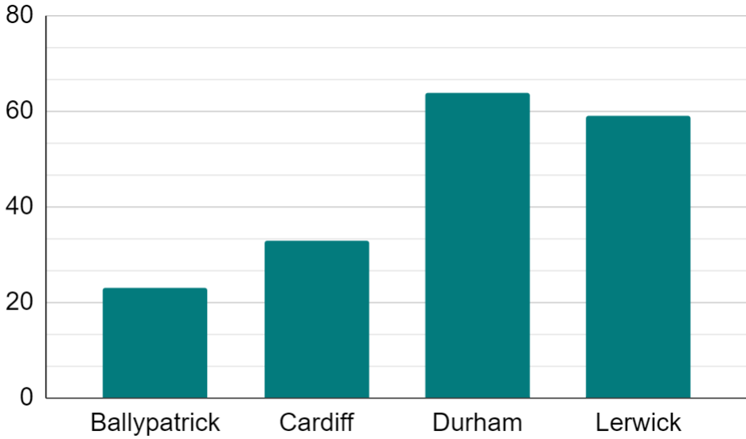
Statistical problems - data presentations
3) The table shows weather data from The Met Office for four locations in 1995.
location | days with airfrost
Ballypatrick Forest | 23
Cardiff | 33
Durham | 64
Lerwick | 59
Plot a graph to illustrate how the total number of days with airfrost differs between the four locations.
days with airfroost
location
Mathematics in Education and Industry
v2.2

